Slide 1

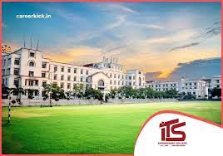
IMAGE Classifier
In THE GUIDANCE OF Mrs. Nisha Vashishth
Presented by : Rakshit Tyagi (1902220100121) & pragati kumari (1902220100106)

Slide 2
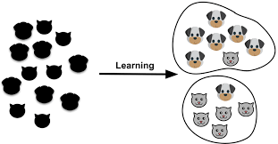
Content :
• Loaded ensembles of training images of cats and of dogs.
• Mean-averaged both training ensembles.
• Called tf to get a training basis for cats and of dogs.
• Retained 95% of the cumulative energy in each ensemble.
• Loaded ensembles of testing images of cats and of dogs.
• Mean average both testing ensembles.
• For each test image:
– Projected the test image onto the training basis for cats and the training basis for dogs.
– Took the two norm of both projections.
– If the cat-basis norm was larger than the dog-basis norm then classified the test image as a cat, else as a dog.
• Computed success rates.

Slide 3
Introduction:
Deep learning is a type of machine learning and artificial intelligence (AI) that imitates the way humans gain certain types of knowledge. Deep learning is an important element of data science, which includes statistics and predictive modeling.
When classifying cats and dogs, the overall outline of an animal’s face is one of the most distinguishing features of the two creatures. The fur color, though the most distinguishing feature the two creatures, does not classify the animals well. For example, a correlation between dogs may misclassify the brighter images as cats just because it is brighter. Still, the texture of the fur color is useful in distinguishing the two creatures. Wavelets allow us to pick up the outline of the faces and, if we remove one of the wavelet layer of coefficients (which we will go in to detail), still disregard the fur color. Also, the coefficients specify the types of texture of the fur color. This texture feature facilitates the classification because the fur textures of the cats are fairly distinct from dogs. Thus, wavelets are appropriate to extract these features.
Transfer learning (TL) is a research problem in machine learning. (ML) that focuses on storing knowledge gained while solving one problem and applying it to a different but related problem.

Slide 4
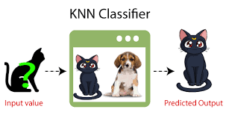
K-NN algorithm
The k-nearest neighbors algorithm, also known as KNN or k-NN, is a non-parametric, supervised learning classifier, which uses proximity to make classifications or predictions about the grouping of an individual data point.

Slide 5
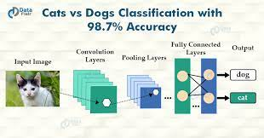
Convolutional Neural Network (CNN) is an algorithm taking an image as input then assigning weights and biases to all the aspects of an image and thus differentiates one from the other. Neural networks can be trained by using batches of images, each of them having a label to identify the real nature of the image (cat or dog here). A batch can contain few tenths to hundreds of images

Slide 6
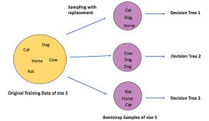
Random forest is a Supervised Machine Learning Algorithm that is used widely in Classification and Regression problems. It builds decision trees on different samples and takes their majority vote for classification and average in case of regression.

Slide 7
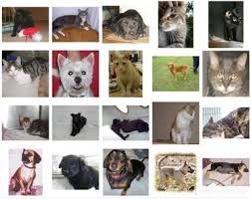
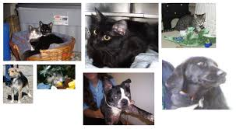
Steps to predict an image type :
Load an image.
Resize it to a predefined size such as 224 x 224 pixels.
Scale the value of the pixels to the range [0, 255].
Select a pre-trained model.
Run the pre-trained model.
Display the results.

Slide 8
Deep Learning Project – Cats and Dogs Classification

Slide 9
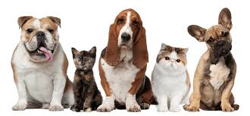
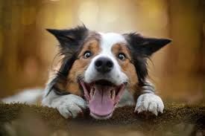
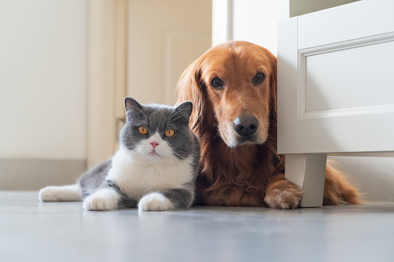
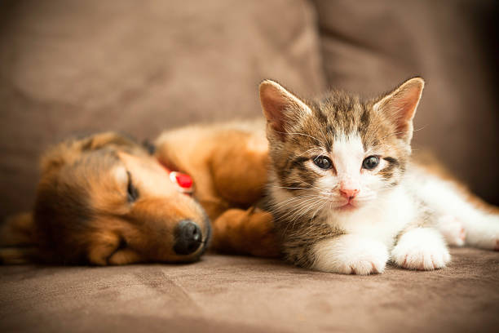
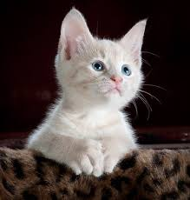

Slide 10


GitHub:
https://github.com/Pragati01234/Dog-vs-cat/blob/main/DL_Project_3_Dog_vs_Cat_Classification_Transfer_Learning.ipynb
G-Colab :
https://colab.research.google.com/drive/1VZOwI_66v-Wa9-tMXYKE8KjwljQMvWc1

